Slide 1
Entity Relationship Diagram
Ref: Korth (Chapter 7, Section 7.5)

Slide 2
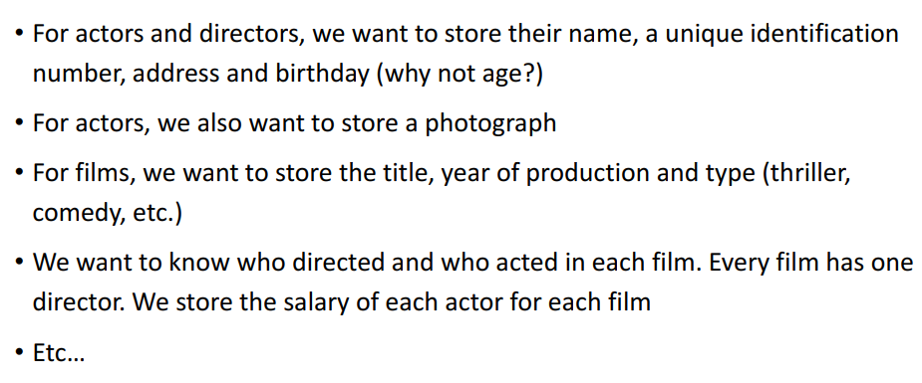
Requirement Analysis Example: IMDB

Slide 3
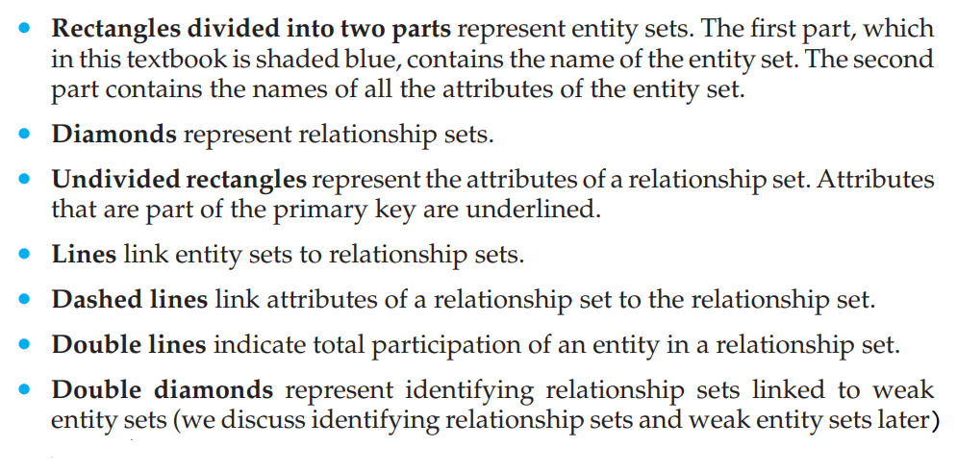
Notations

Slide 4
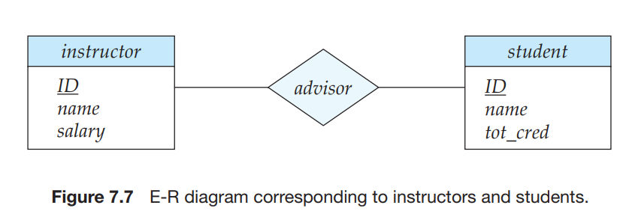
Notations

Slide 5
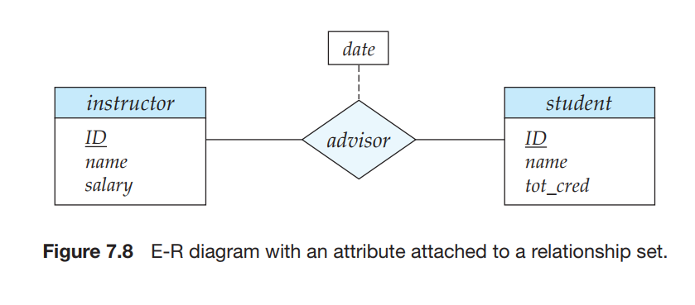
Notations
Attributes in Relationship

Slide 6
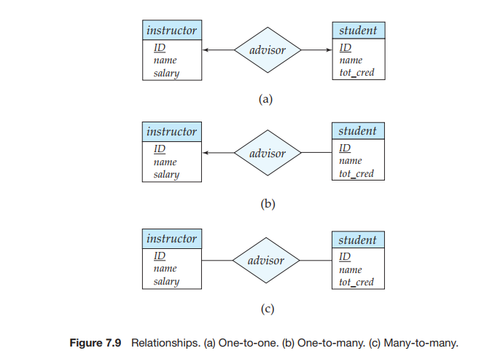
Notations
Relationships

Slide 7
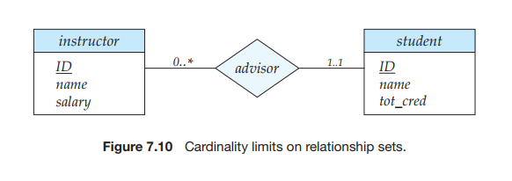
Notations
Cardinality

Slide 8
Types
of Attributes
▪
Simple
▪
Multi-valued
–
–
Cannot
be subdivided
–
–
Can have many values
Person may have several
university (or college)
degrees
Age, sex, marital status
▪
Composite
–
Can be subdivided into additional attributes
▪
Derived
–
Address into street, postcode (or zip)
city,
–
Can be derived with
algorithm
Age can be derived from
date of birth
▪
Single-valued
–
–
Can have only a single
value
Person has one social
security number
–

Slide 9
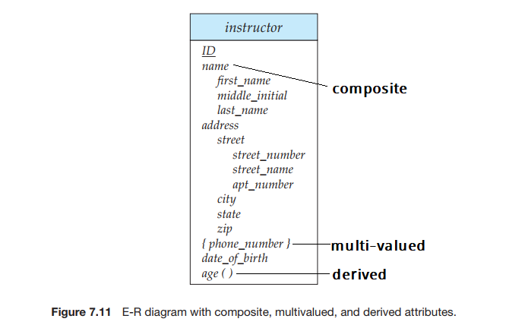
Notations
Composite, Multi-valued, and Derived Attributes

Slide 10
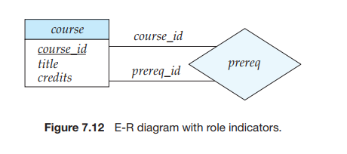
Notations
Role

Slide 11
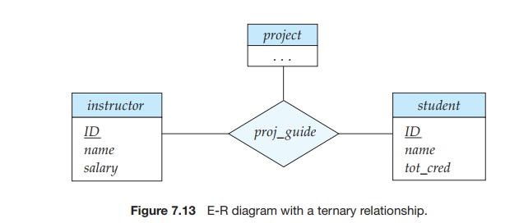
Notations
Ternary Relationship
We permit at most one arrow out of a relationship set

Slide 12
Strong and Weak Entity
An entity set that does not have sufficient attributes to form a primary key is termed a weak entity set.
An entity set that has a primary key is termed a strong entity set.

Slide 13
Strong and Weak Entity
For a weak entity set to be meaningful, it must be associated with another entity set, called the identifying or owner entity set.
Every weak entity must be associated with an identifying entity; that is, the weak entity set is said to be existence dependent on the identifying entity set.
The identifying entity set is said to own the weak entity set that it identifies.
The relationship associating the weak entity set with the identifying entity set is called the identifying relationship.

Slide 14
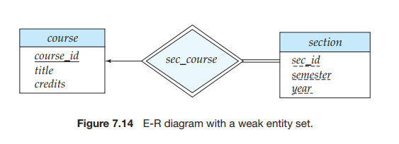
Notations
Strong and Weak Entity

Slide 15
Strong and Weak Entity
Although a weak entity set does not have a primary key, we nevertheless need a means of distinguishing among all those entities in the weak entity set that depend on one particular strong entity. The discriminator of a weak entity set is a set of attributes that allows this distinction to be made.
For example, the discriminator of the weak entity set section consists of the attributes sec id, year, and semester, since, for each course, this set of attributes uniquely identifies one single section for that course. The discriminator of a weak entity set is also called the partial key of the entity set.
The primary key of a weak entity set is formed by the primary key of the identifying entity set, plus the weak entity set’s discriminator. In the case of the entity set section, its primary key is {course id, sec id, year, semester}, where course id is the primary key of the identifying entity set, namely course, and {sec id, year, semester} distinguishes section entities for the same course.

Slide 16
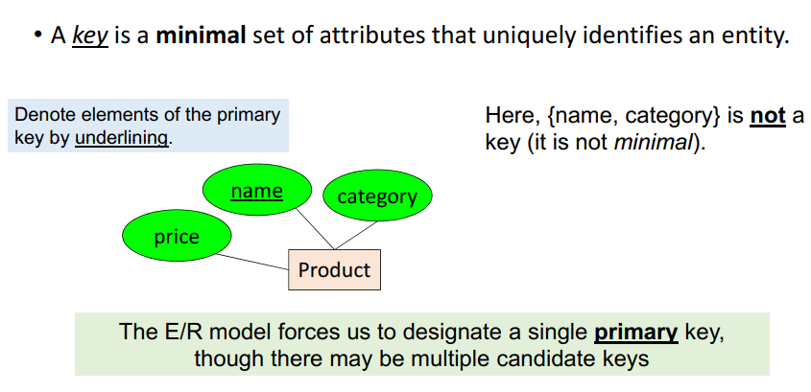
Primary Key

Slide 17
Practice 1
Design the ER Diagram for IMDB System

Slide 18
Practice 2
Construct an E-R diagram for a car-insurance company whose customers own one or more cars each.
Each car has associated with it zero to any number of recorded accidents. Accidents are recorded with a date, location, and a report number to uniquely identify an accident.
Every car has a driver, and for each reported accident, a driver has to pay a damage amount.

Slide 19
Practice 3
Consider the situation of a hospital. There are several doctors. A patient can set an appointment with any doctor, for which appointment date must be recorded. A doctor may suggest a patient to take a medical test, for which the log must be recorded. Construct an E-R diagram for this situation.

Slide 20
Practice 4
Consider the situation of a hospital. There are several doctors. A patient can set an appointment with any doctor, for which appointment date must be recorded. A doctor may suggest a patient to take a medical test, for which the log must be recorded. Construct an E-R diagram for this situation.
Now let, we want to record which test is performed by which doctor. What will be the changes in your previous diagram?

